Slide 1
Exercises
Using the screenshots and information provided, determine authorized access points for works and expressions, persons, families, and corporate bodies and record entity attributes if readily available and ascertainable

Slide 2
Work/Expression Exercises

Slide 3
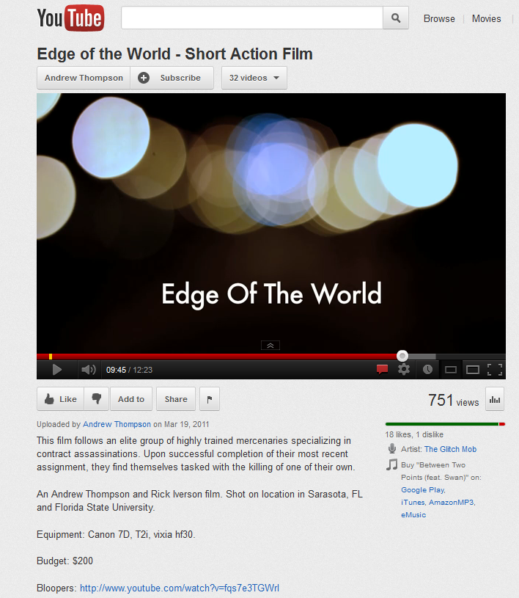
Exercise 1 – Determine authorized access point for this work

Slide 4
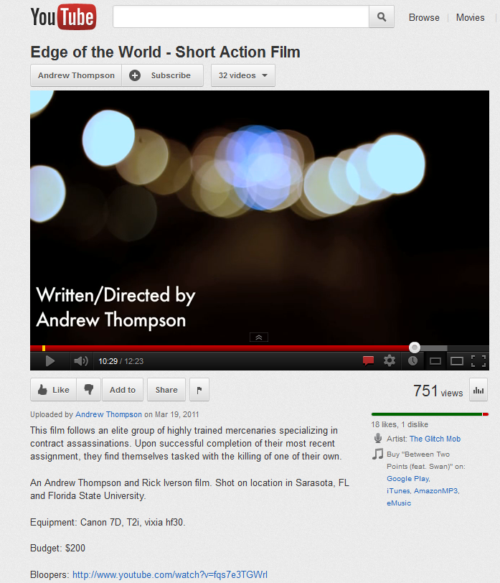

Slide 5
Info you’ve found
Results of a search of the NAF for the title Edge of the world:
100 1_ Anderman, Janusz, $d 1949- $t Kraj świata. $l English
400 1_ Anderman, Janusz, $d 1949- $t Edge of the world
100 1_ Childs, Barney. $t Edge of the world
100 1_ Powell, Michael, $d 1905-1990. $t 200,000 feet on Foula
400 1_ Powell, Michael, $d 1905-1990. $t Edge of the world
130 _0 Edge of the world (Motion picture)
SEE AUTHORITY RECORD ON NEXT PAGE

Slide 6
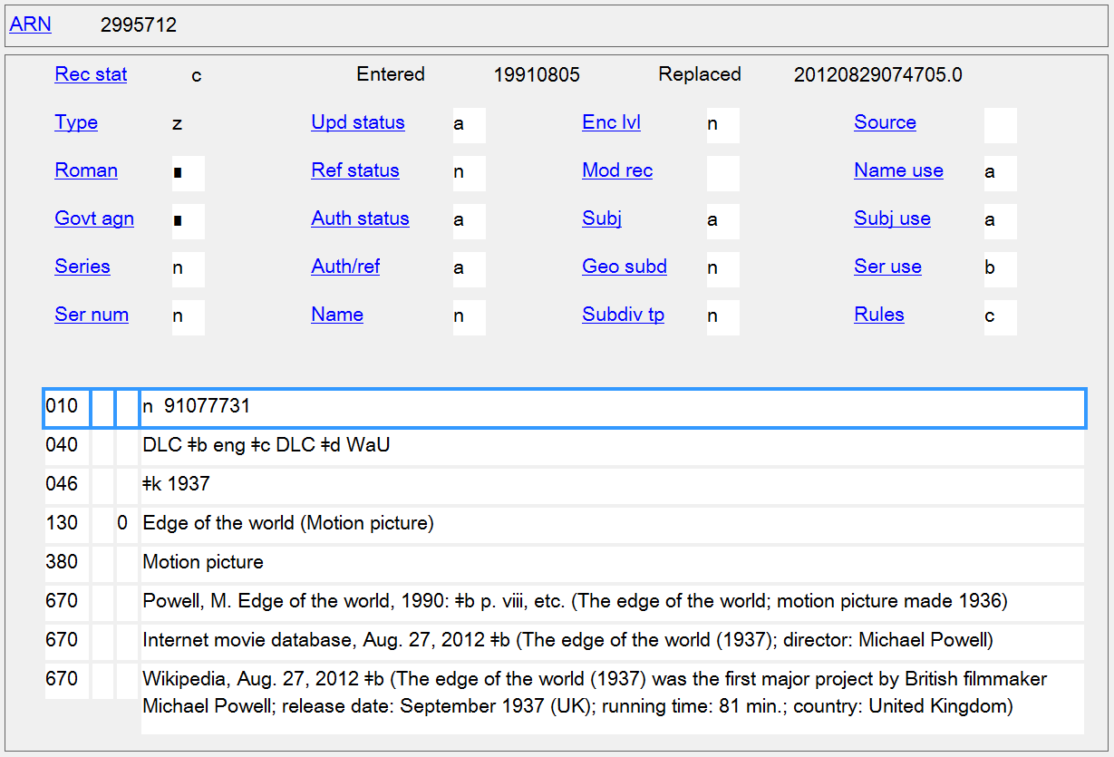

Slide 7
More info you’ve found
Results of IMDb search for Edge of the world:
The Edge of the World (1937)
The Edge of the World (2005)
The Edge of the World (2009)
The Edge of the World: BC’s Early Years (2010)
Edge of the World (2011) SEE SCREENSHOT FROM IMDb
The Edge of the World (2011) SEE SCREENSHOT FROM IMDb

Slide 8
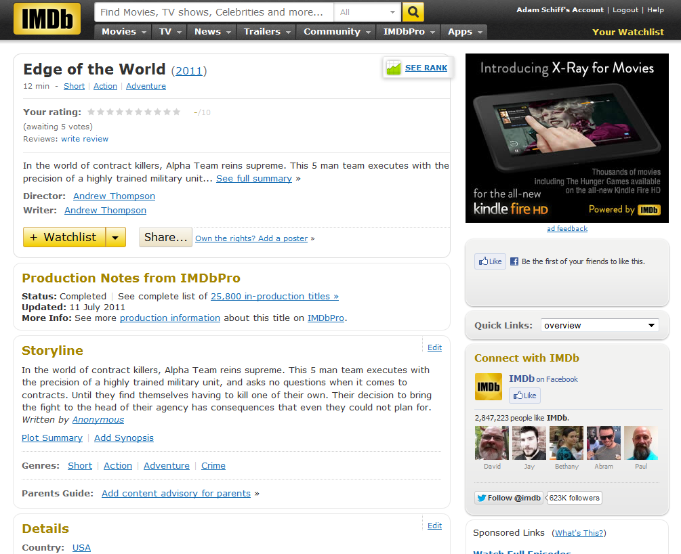

Slide 9
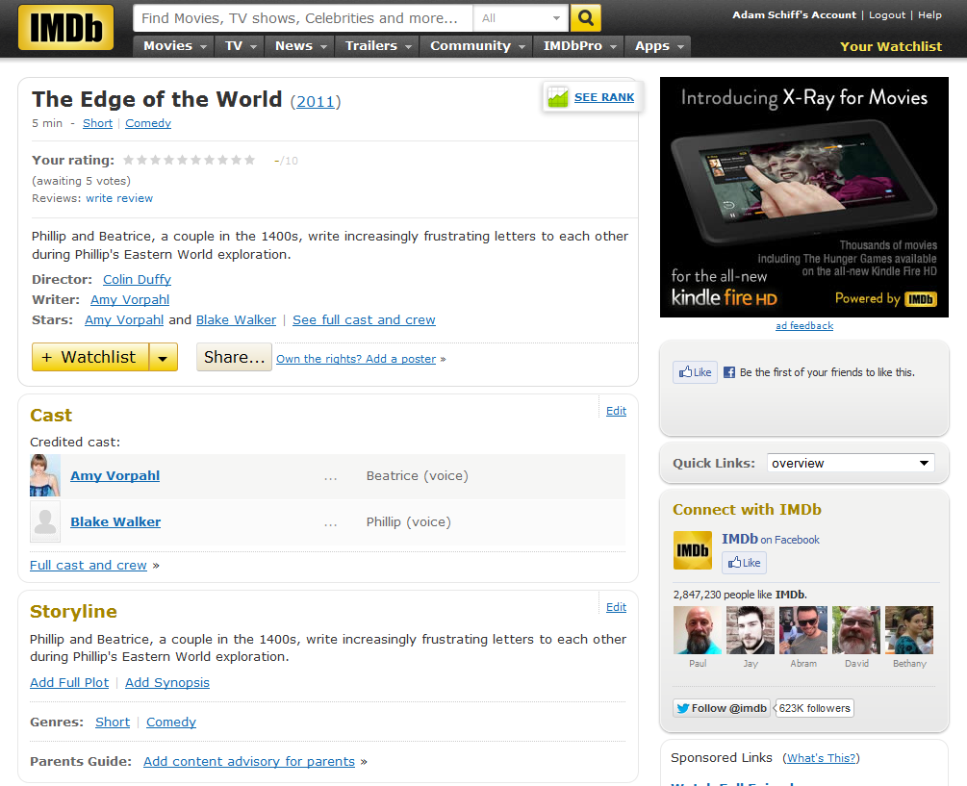

Slide 10
* Preferred title for the work:
** Form of work (MARC 380):
** Date of work (MARC 046 $k $l):
** Place of origin of the work (MARC 370 $g):
** Other distinguishing characteristic of the work (MARC 381):
History of the work (MARC 678):
Authorized access point for the work:
1__ __ $a
* Core element
** Core element when needed to differentiate a work from another work with the same title or from the name of a person, family, or corporate body.

Slide 11
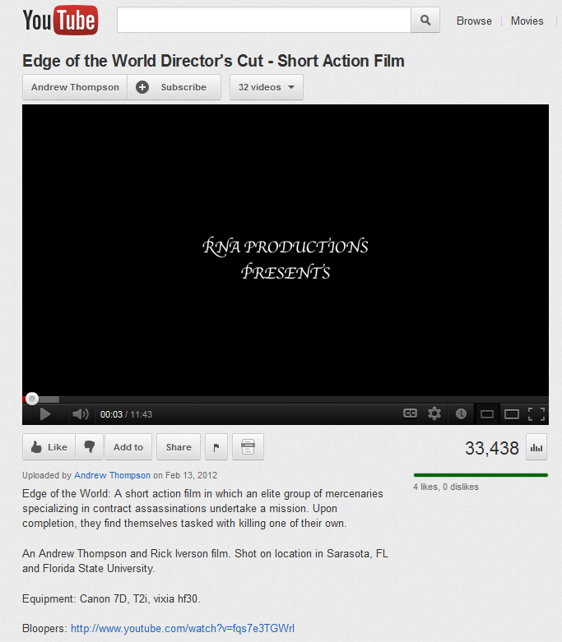
Exercise 2 – Determine authorized access point for this resource

Slide 12
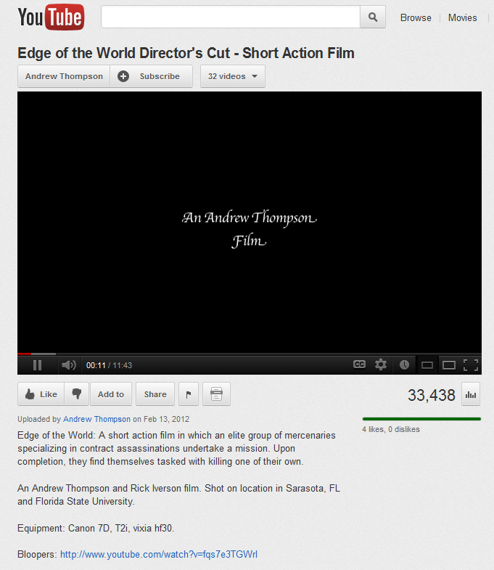

Slide 13
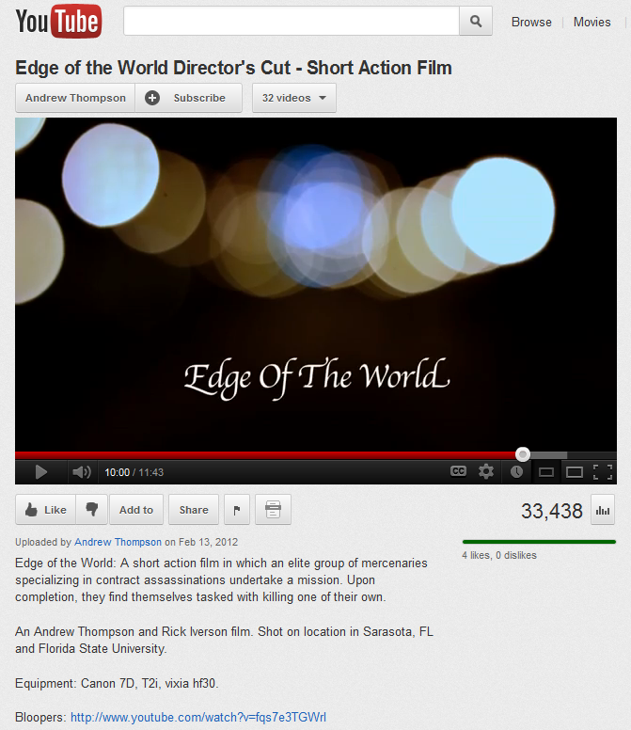

Slide 14
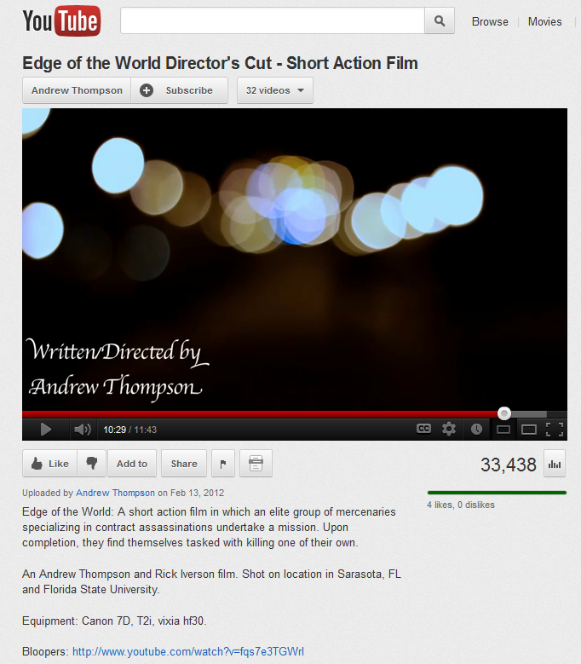

Slide 15
Authorized access point for the work:
* Content type (MARC 336):
** Date of expression (MARC 046 $k/$l):
** Language of expression (MARC 377 $a $l):
** Other distinguishing characteristic of the expression (MARC 381):
Authorized access point for the expression:
1__ __ $a
* Core element
** Core element when needed to differentiate an expression of a work from another expression of the same work

Slide 16
Exercise 3 – Determine the authorized access point(s) for expressions of this resource

Slide 18
LANGUAGES: ENGLISH, FRENCH (Doublé au Québec), SPANISH, THAI 5.1 Dolby Digital, ENGLISH - Audio Description Track Dolby Surround
SUBTITLES: ENGLISH, ENGLISH SDH, FRENCH, SPANISH, CHINESE, KOREAN, THAI

Slide 19
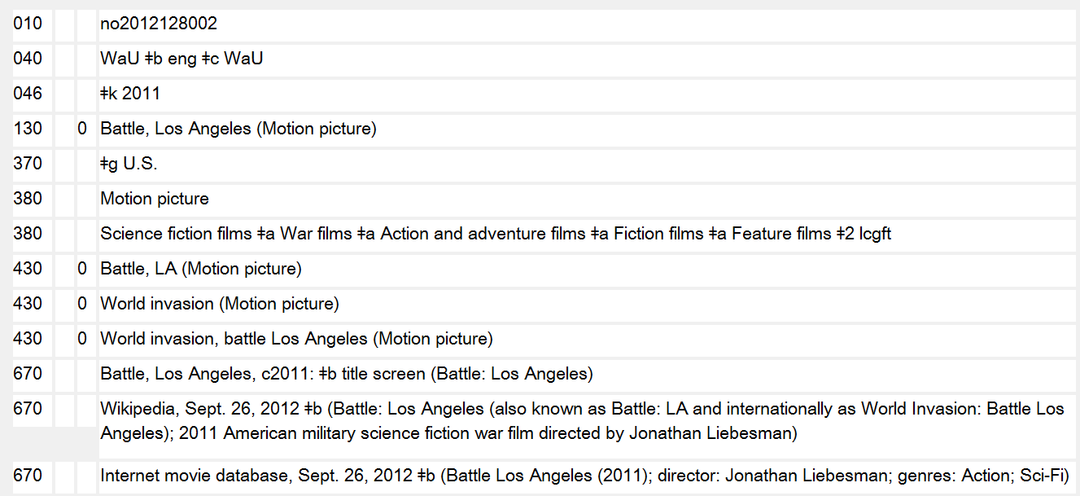

Slide 20
Access Points to Include in the Bibliographic Record
___ __ $a
___ __ $a
___ __ $a
___ __ $a
___ __ $a
___ __ $a
___ __ $a
___ __ $a
___ __ $a
___ __ $a

Slide 21
Exercise 4a – Determine the authorized access point for the part of the work
Authority record found for the work:
130 _0 Glee (Television program)

Slide 22
Exercise 4b – Determine the authorized access point for the part of the work
Authority record found for the work:
130 _0 Good wife
(Television
program)
SEE ALSO INFO FROM EPGUIDES.COM ON NEXT SLIDE

Slide 23
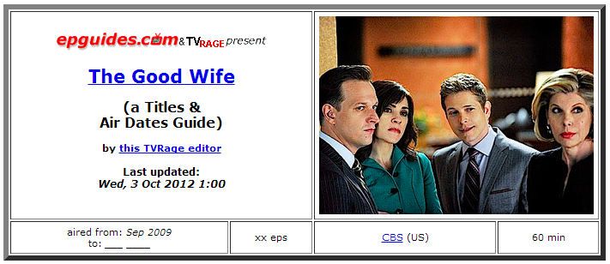
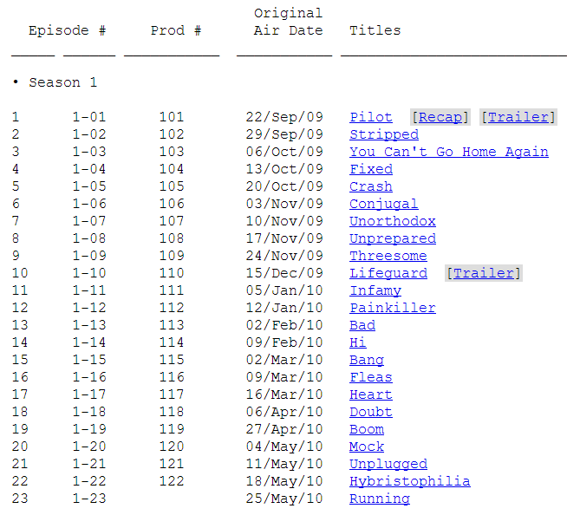
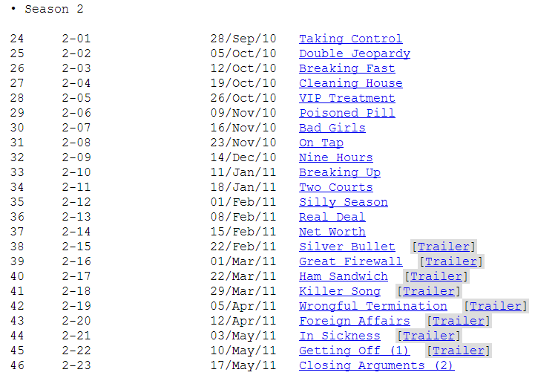

Slide 24
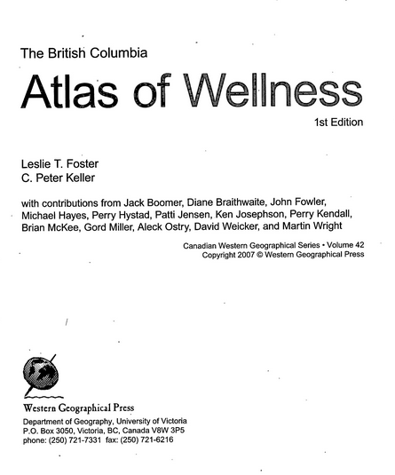
Exercise 5a – Determine the authorized access point for this work
Authority records found for entities related to this resource:
100 1_ Foster, Leslie T., $d
1947-
100 1_ Keller, C. Peter
100 1_ Boomer, Jack
110 2_ Western Geographical
Press
110 2_ University of Victoria
(B.C.). $b Department
of Geography

Slide 25
Exercise 5b – Determine the authorized access point for this work
Authority records found for entities related to this resource:
100 1_ Shaw, Mary, $d 1968-
100 1_ Thomas, Bethan
100 1_ Boomer, Jack
100 1_ Smith, George Davey
100 1_ Dorling, Daniel
110 2_ Policy Press

Slide 26
Exercise 5c – Determine the authorized access point for this work
Authority records found for entities related to this resource:
110 1_ Canada. $b Indian and
Northern Affairs Canada
100 1_ Anderson, Erik, $d 1966-
110 2_ Public History Inc.
100 1_ Bonesteel, Sarah

Slide 27
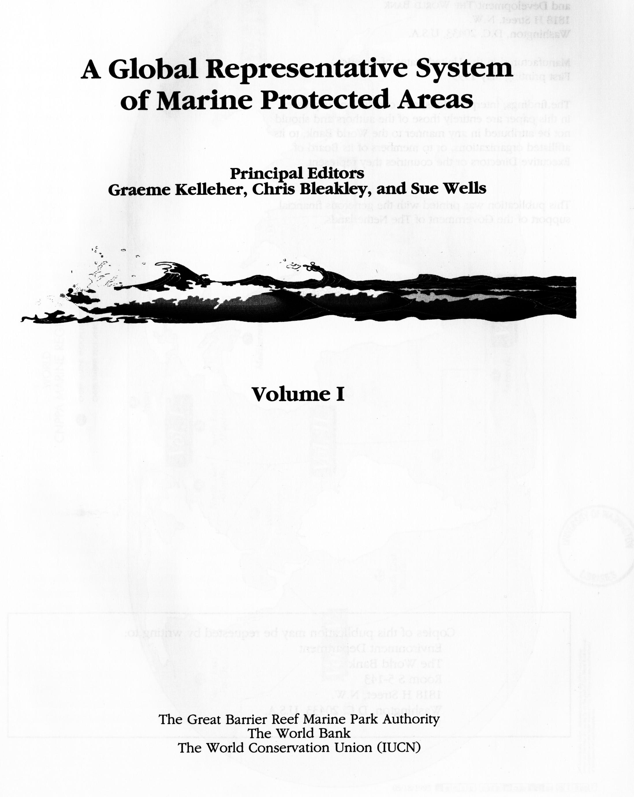
Exercise 5d – Determine the authorized access point for this work
Authority records found for entities related to this resource:
100 1_ Kelleher, Graeme
100 1_ Bleakley, Chris
100 1_ Wells, Sue
110 2_ Great Barrier Reef
Marine Park Authority
110 2_ World Bank
110 2_ IUCN--The World
Conservation Union

Slide 28
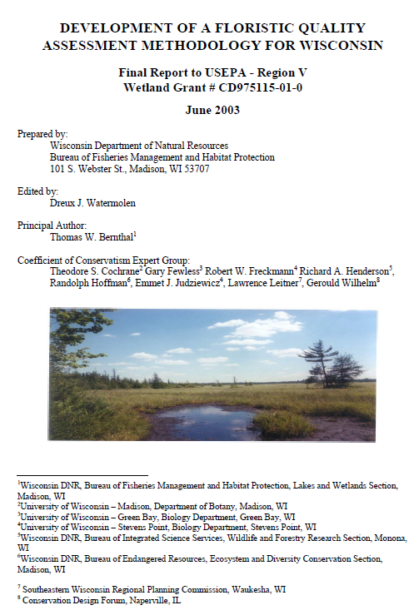
Exercise 5e – Determine the authorized access point for this work
Authority records found for entities related to this resource:
110 1_ United States. $b
Environmental Protection
Agency. $b Region V
110 1_ Wisconsin. $b Bureau of
Fisheries Management &
Habitat Protection
100 1_ Watermolen, Dreux J.
100 1_ Bernthal, Thomas W.
110 2_ Coefficient of Conservatism
Expert Group (Wis.)

Slide 29
Personal Name Exercises

Slide 30
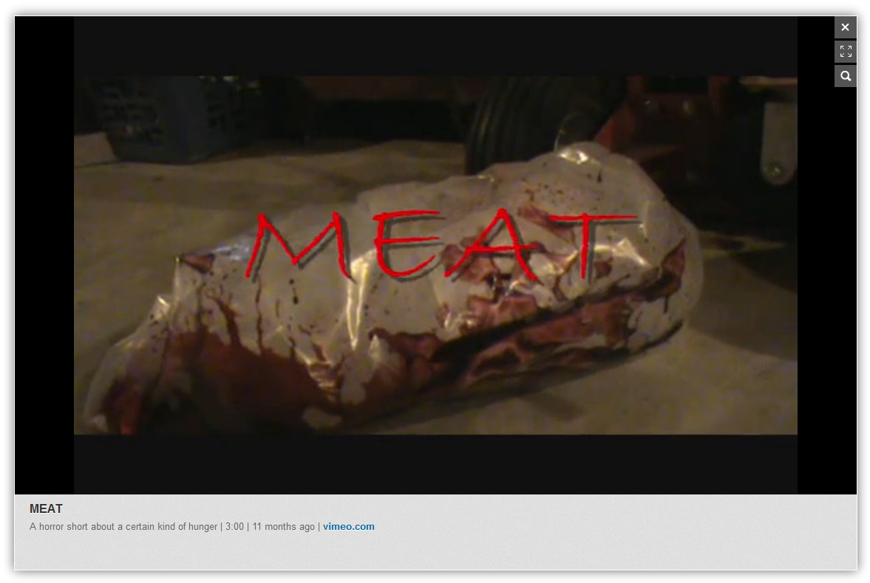
Exercise 1 – Determine authorized access point for the film’s director/writer
Notes:
Determine the authorized access point for the director of the film “Meat.”

Slide 33
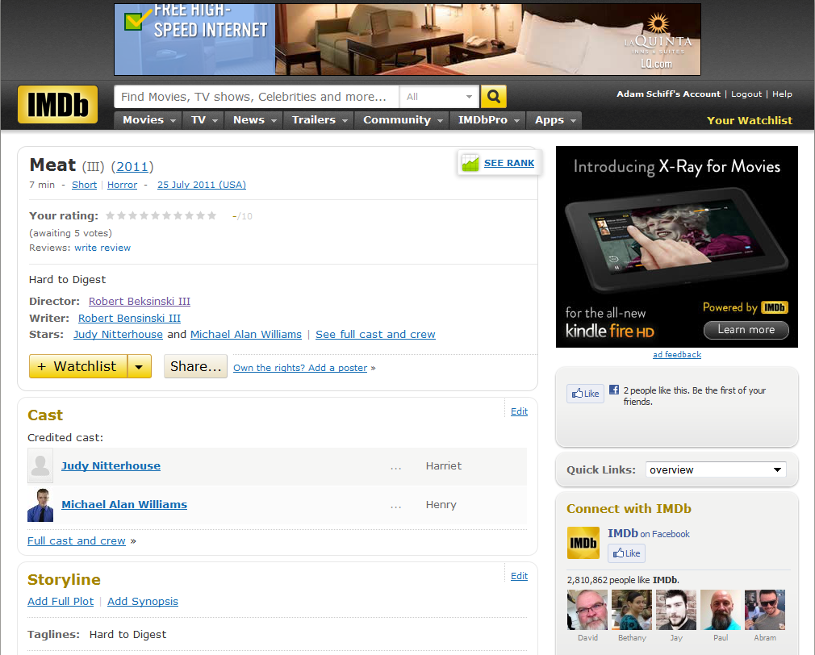
IMDb record for Meat

Slide 34
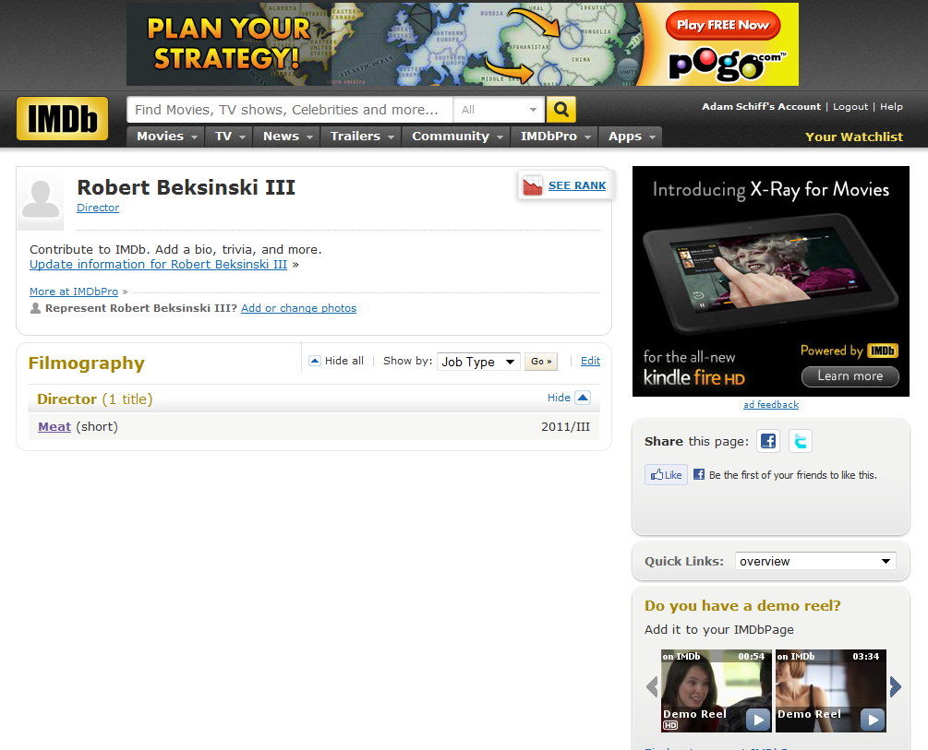
IMDb record for Beksinski
Additional information: nothing found in OCLC search of bibliographic and authority files

Slide 35
Preferred name for the person:
* Date of birth (MARC 046 $f):
* Date of death (MARC 046 $g):
** Period of activity of the person (MARC 046 $s $t):
* Title of the person (MARC 368 $d):
** Fuller form of name (MARC 378 $q):
* Other designation associated with the person (MARC 368 $c):
Gender (MARC 375):
Place of birth (MARC 370 $a):
Place of death (MARC 370 $b):
Country associated with the person (MARC 370 $c):
Place of residence (MARC 370 $e):
Address of the person (MARC 371):
Affiliation (MARC 373):
Language of the person (MARC 377):
Field of activity of the person (MARC 372):
** † Profession or occupation (MARC 374):
Biographical information (MARC 678):
Authorized access point for the work:
1__ __ $a
* Core element
** Core element if needed to distinguish persons with the same name
† Core element for person whose name consists of a phrase or appellation not conveying the idea of a person

Slide 36
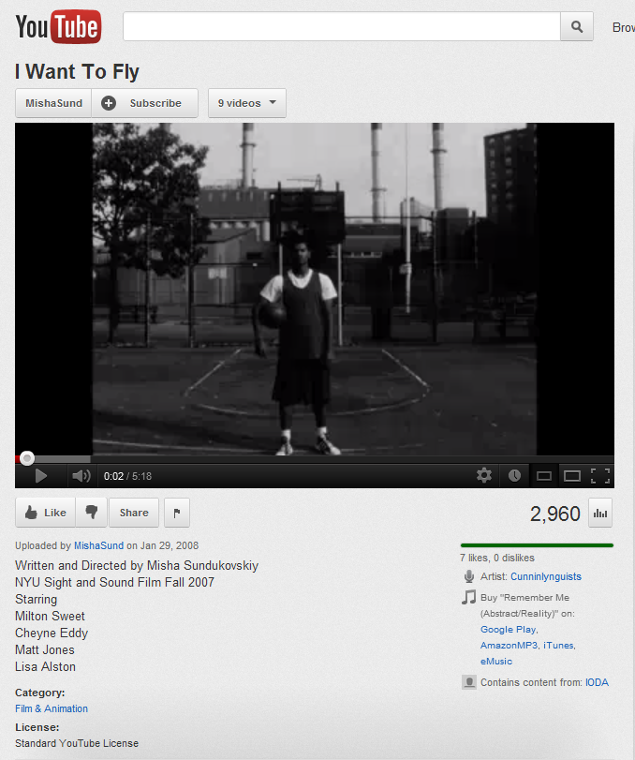
Exercise 2 – Determine the authorized access point for the actor Matt Jones
Notes:
Establish the access point for the actor Matt Jones.

Slide 37
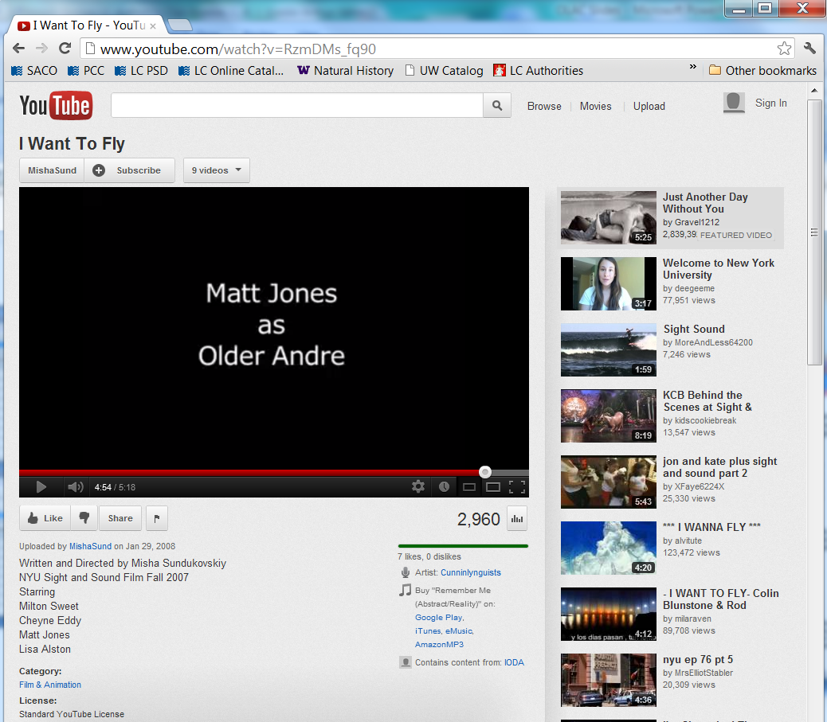

Slide 38
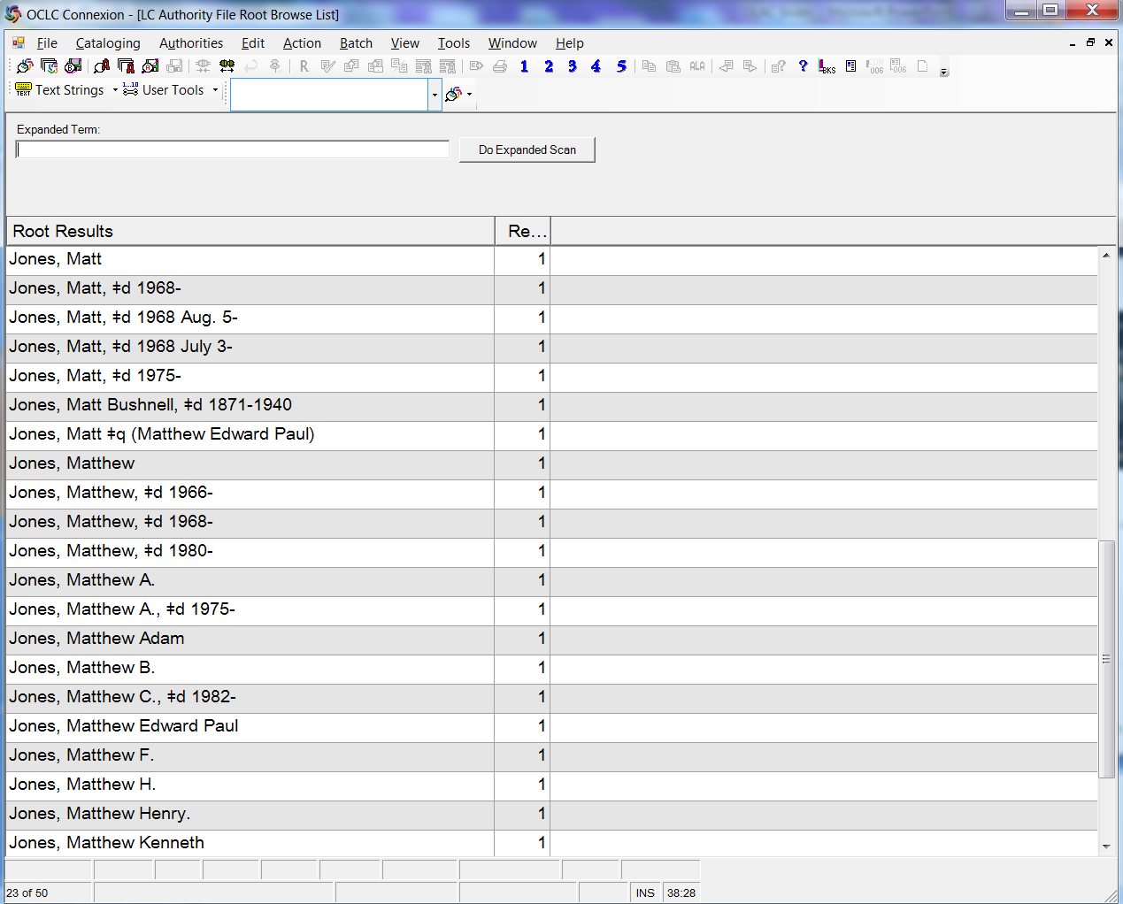
OCLC personal name browse of the authority file. After searching OCLC authority and bibliographic records, you determine that your person is not yet established.
Notes:
After looking through all of these authority records, you are certain that none of them represent your person. So you look in reference sources online to see if you can find more information.

Slide 39
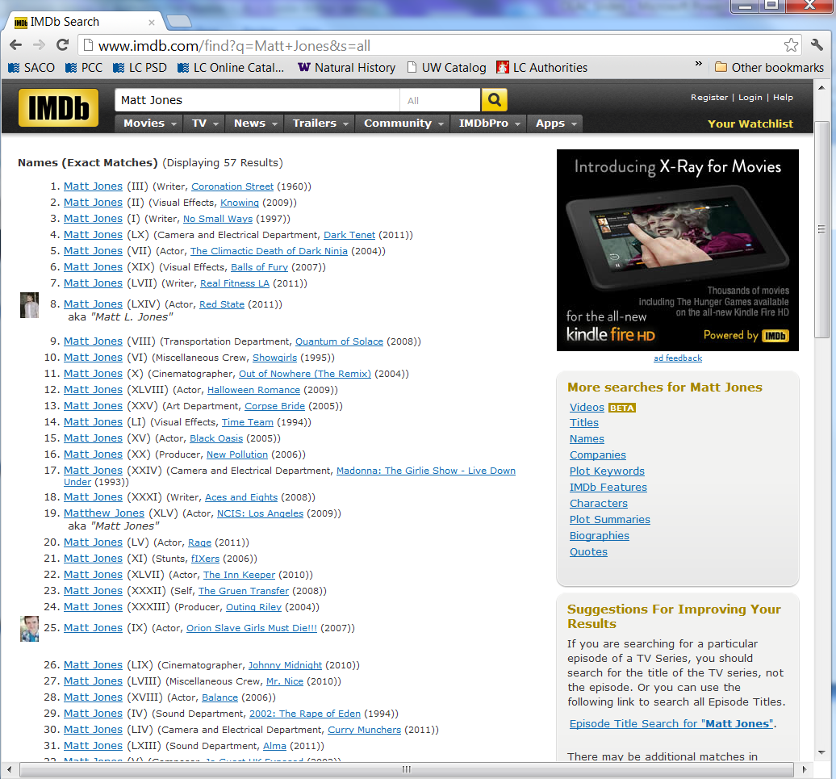
IMDb search for Matt Jones

Slide 40
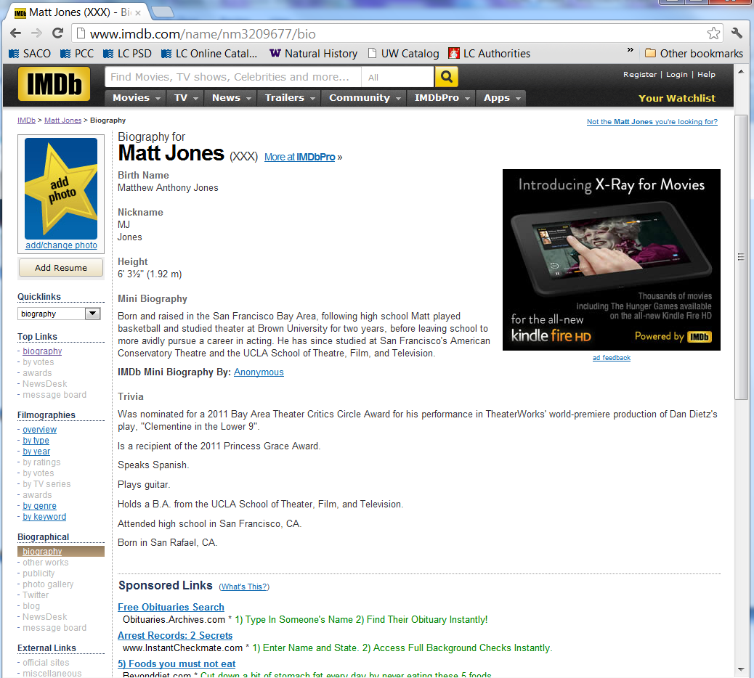
IMDb record for your Matt Jones

Slide 41
Preferred name for the person:
* Date of birth (MARC 046 $f):
* Date of death (MARC 046 $g):
** Period of activity of the person (MARC 046 $s $t):
* Title of the person (MARC 368 $d):
** Fuller form of name (MARC 378 $q):
* Other designation associated with the person (MARC 368 $c):
Gender (MARC 375):
Place of birth (MARC 370 $a):
Place of death (MARC 370 $b):
Country associated with the person (MARC 370 $c):
Place of residence (MARC 370 $e):
Address of the person (MARC 371):
Affiliation (MARC 373):
Language of the person (MARC 377):
Field of activity of the person (MARC 372):
** † Profession or occupation (MARC 374):
Biographical information (MARC 678):
Authorized access point for the work:
1__ __ $a
* Core element
** Core element if needed to distinguish persons with the same name
† Core element for person whose name consists of a phrase or appellation not conveying the idea of a person

Slide 42
Exercise 3 – Determine the authorized access point for Sheryl Deane
Notes:
Establish the access point for Sheryl Deane

Slide 43
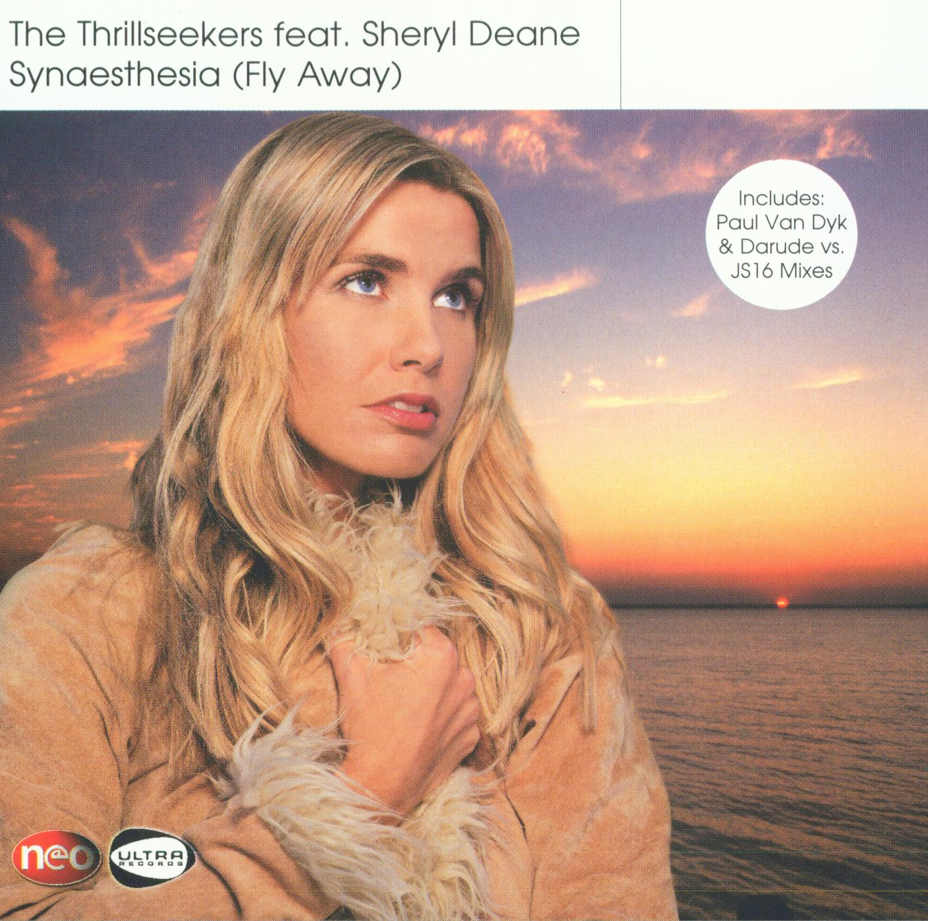

Slide 44
Info you’ve found
Nothing in authority file
Three bib records in OCLC for recordings that have the heading Deane, Sheryl, all of which are this person
Discogs.com has a web page for her:
Sheryl Deane; UK vocalist; in groups: Ruff Loaderz; West End; variations: Sheryl Duane
MusicBrainz.org has a web page for her:
Sheryl Deane; person; female; United Kingdom
Sandrareynolds.co.uk has a web page for her:
Sheryl Deane; skills: improvisation & devising; presenting; singing; languages: English; acted in television, film, theatre, and commercials; was in a girl group; sang with a music act called The Thrillseekers
There is another Sheryl Deane who is a guitarist from Cape Town, South Africa; no recordings in OCLC, but you did find two sound files on Soundcloud of her playing Bach’s Air on G String and Fauré’s Pavane

Slide 45
Preferred name for the person:
* Date of birth (MARC 046 $f):
* Date of death (MARC 046 $g):
** Period of activity of the person (MARC 046 $s $t):
* Title of the person (MARC 368 $d):
** Fuller form of name (MARC 378 $q):
* Other designation associated with the person (MARC 368 $c):
Gender (MARC 375):
Place of birth (MARC 370 $a):
Place of death (MARC 370 $b):
Country associated with the person (MARC 370 $c):
Place of residence (MARC 370 $e):
Address of the person (MARC 371):
Affiliation (MARC 373):
Language of the person (MARC 377):
Field of activity of the person (MARC 372):
** † Profession or occupation (MARC 374):
Biographical information (MARC 678):
Authorized access point for the work:
1__ __ $a
* Core element
** Core element if needed to distinguish persons with the same name
† Core element for person whose name consists of a phrase or appellation not conveying the idea of a person

Slide 46
Family Name Exercise

Slide 48
Info you’ve found
Jim Bob and Michelle Duggar married July 21, 1984; first child, Joshua, was born March 3, 1988
No name authority for any family named Duggar
LCSH heading established:
100 3_ Dugger family
400 3_ Duggar family
The Duggars live in Tontitown, Arkansas
Authority records found:
100 1_ Duggar, Jim Bob
100 1_ Duggar, Michelle
151 __ Tontitown (Ark.)

Slide 49
* Preferred name for the family:
* Type of family (MARC 376 $a):
* Date associated with the family (MARC 046 $s $t):
** Place associated with the family (MARC 370 $c $e $f):
** Prominent member of the family (MARC 376 $b):
Hereditary title (MARC 376 $c):
Family history (MARC 678):
Authorized access point for the family:
1__ __ $a
* Core element
** Core element if needed to distinguish a family from another family with the same name

Slide 50
Corporate Name Exercises

Slide 51
Exercise 1 – Determine the authorized access point for the festival. Resource being cataloged is its website.

Slide 52
Info you’ve found
Began in a small meeting room of a Dallas hotel in 1978
Original name: Greater Southwest Vintage Guitar Show
Annual event
Since 2004 held at Dallas Market Hall
Founded by Charley Wirz, John Brinkman, and Danny Thorpe

Slide 53
* Preferred Name for the Corporate Body:
* Location of Conference, Etc. (MARC 370 $e):
** Location of Headquarters (MARC 370 $e):
* Date of Conference, Etc. (MARC 046 $s $t):
* Date of Establishment (MARC 046 $s):
* Date of Termination (MARC 046 $t):
† ††Associated Institution MARC 373):
* Number of a Conference, Etc.:
‡ **Other Designation Associated with the Corporate Body (MARC 368 $a $b $c):
Language of the Corporate Body (MARC 377):
Address of the Corporate Body (MARC 371):
Field of Activity of the Corporate Body (MARC 372):
Corporate History (MARC 678):
Authorized access point for the corporate body: 1__ __ $a
* Core element
** Core element if needed to distinguish a corporate body from another corporate body with the same name
† Core element for conferences if name provides better identification than local place or if local place unknown or cannot be readily ascertained
†† Core element for other corporate bodies if the institution’s name provides better identification than the local place name or if the local place name is unknown or cannot be readily determined, and it is needed to distinguish the corporate body from another corporate body with the same name
‡ Core element for a body with a name that does not convey the idea of a corporate body

Slide 54
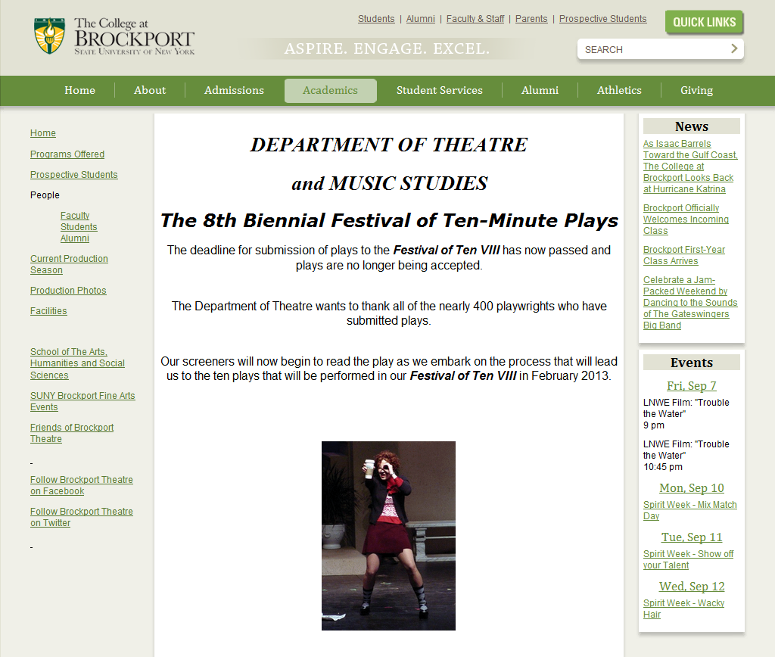
Exercise 2a – Determine the authorized access point for this festival. Assume that you are cataloging a set of videos of plays presented over the entire history of the festival.

Slide 55
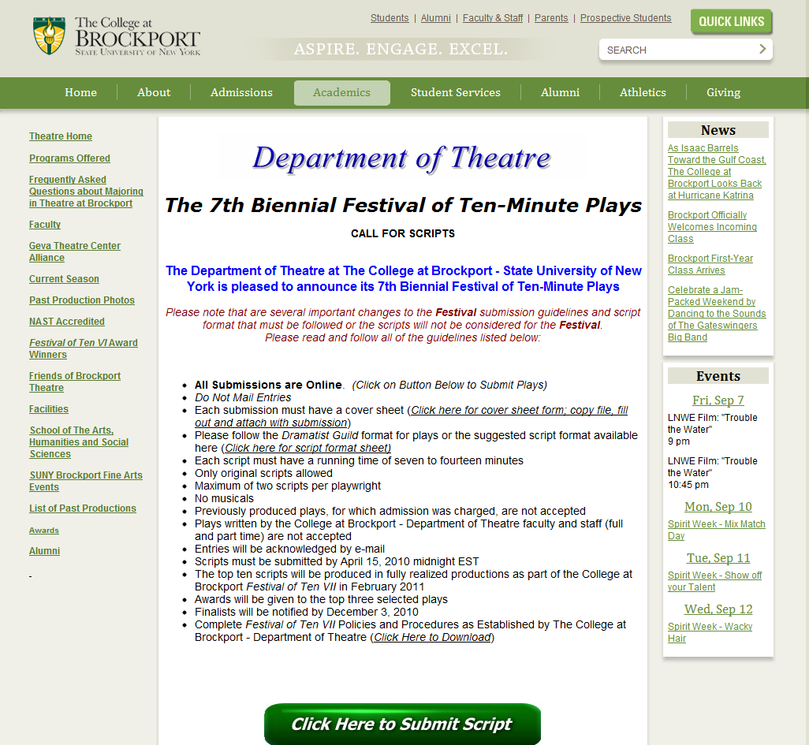

Slide 56
Info you’ve found
Name authority records:
110 2_ State University of New York College at Brockport
410 2_ College at Brockport, State University of New York
151 __ Brockport (N.Y.)

Slide 57
* Preferred Name for the Corporate Body:
* Location of Conference, Etc. (MARC 370 $e):
** Location of Headquarters (MARC 370 $e):
* Date of Conference, Etc. (MARC 046 $s $t):
* Date of Establishment (MARC 046 $s):
* Date of Termination (MARC 046 $t):
† ††Associated Institution MARC 373):
* Number of a Conference, Etc.:
‡ **Other Designation Associated with the Corporate Body (MARC 368 $a $b $c):
Language of the Corporate Body (MARC 377):
Address of the Corporate Body (MARC 371):
Field of Activity of the Corporate Body (MARC 372):
Corporate History (MARC 678):
Authorized access point for the corporate body: 1__ __ $a
* Core element
** Core element if needed to distinguish a corporate body from another corporate body with the same name
† Core element for conferences if name provides better identification than local place or if local place unknown or cannot be readily ascertained
†† Core element for other corporate bodies if the institution’s name provides better identification than the local place name or if the local place name is unknown or cannot be readily determined, and it is needed to distinguish the corporate body from another corporate body with the same name
‡ Core element for a body with a name that does not convey the idea of a corporate body

Slide 58
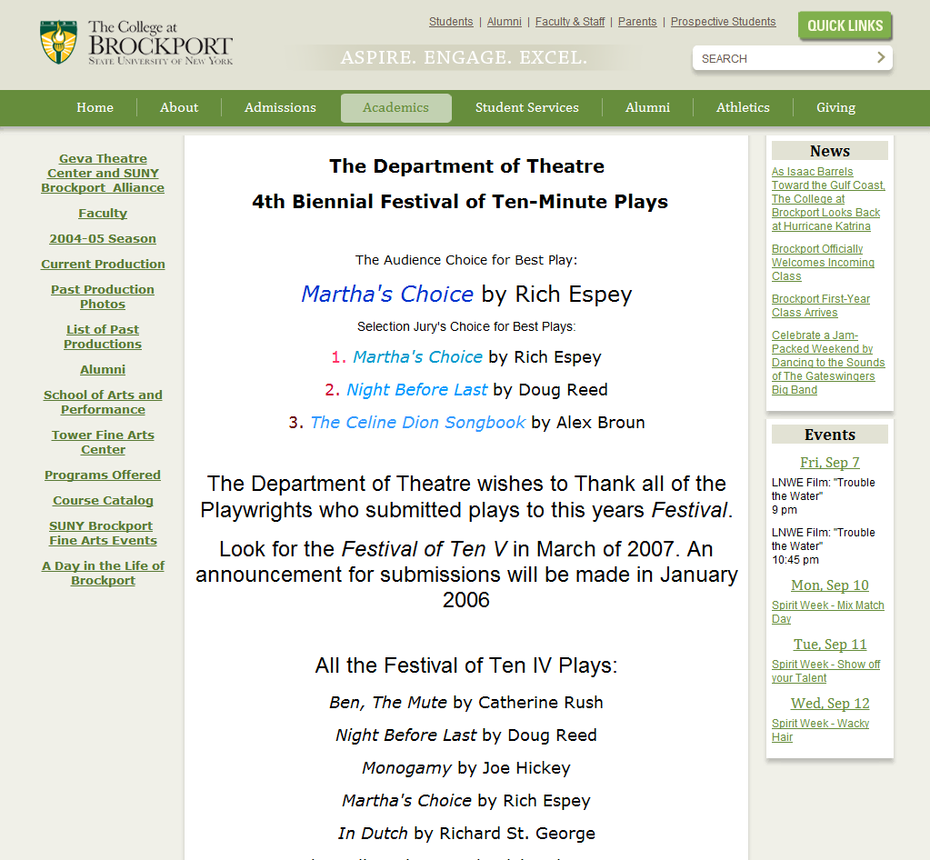
Exercise 2b – What would be the authorized access point for the festival if you had a DVD that recorded the plays presented at this specific festival?

Slide 59
* Preferred Name for the Corporate Body:
* Location of Conference, Etc. (MARC 370 $e):
** Location of Headquarters (MARC 370 $e):
* Date of Conference, Etc. (MARC 046 $s $t):
* Date of Establishment (MARC 046 $s):
* Date of Termination (MARC 046 $t):
† ††Associated Institution MARC 373):
* Number of a Conference, Etc.:
‡ **Other Designation Associated with the Corporate Body (MARC 368 $a $b $c):
Language of the Corporate Body (MARC 377):
Address of the Corporate Body (MARC 371):
Field of Activity of the Corporate Body (MARC 372):
Corporate History (MARC 678):
Authorized access point for the corporate body: 1__ __ $a
* Core element
** Core element if needed to distinguish a corporate body from another corporate body with the same name
† Core element for conferences if name provides better identification than local place or if local place unknown or cannot be readily ascertained
†† Core element for other corporate bodies if the institution’s name provides better identification than the local place name or if the local place name is unknown or cannot be readily determined, and it is needed to distinguish the corporate body from another corporate body with the same name
‡ Core element for a body with a name that does not convey the idea of a corporate body

Slide 60
Exercise 3 – Determine the authorized access point for this corporate body

Slide 61
Jewel box insert

Slide 63
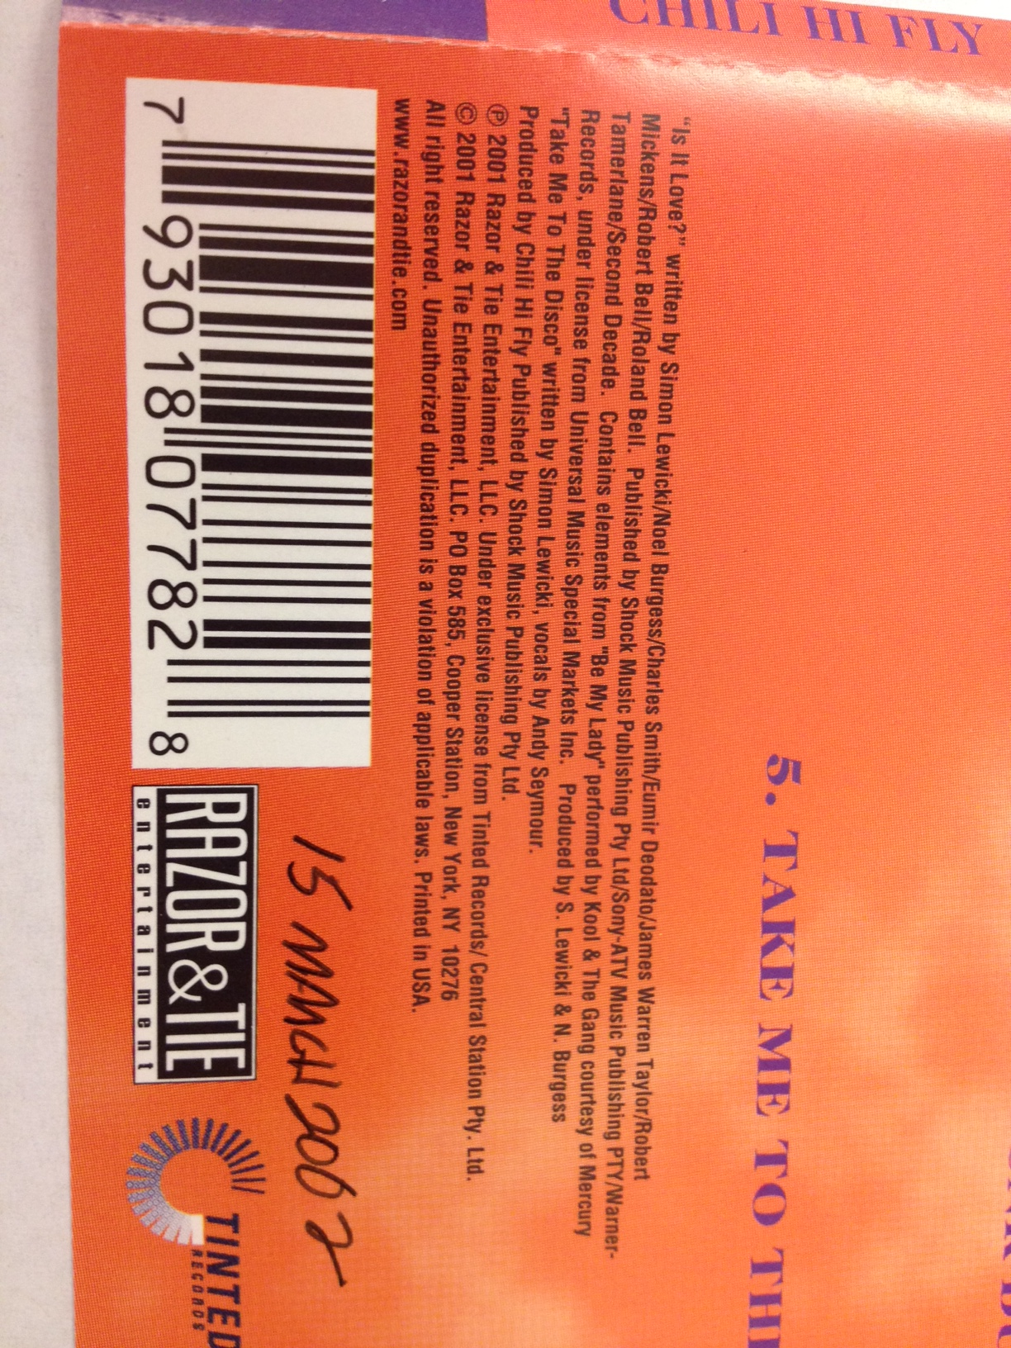

Slide 64
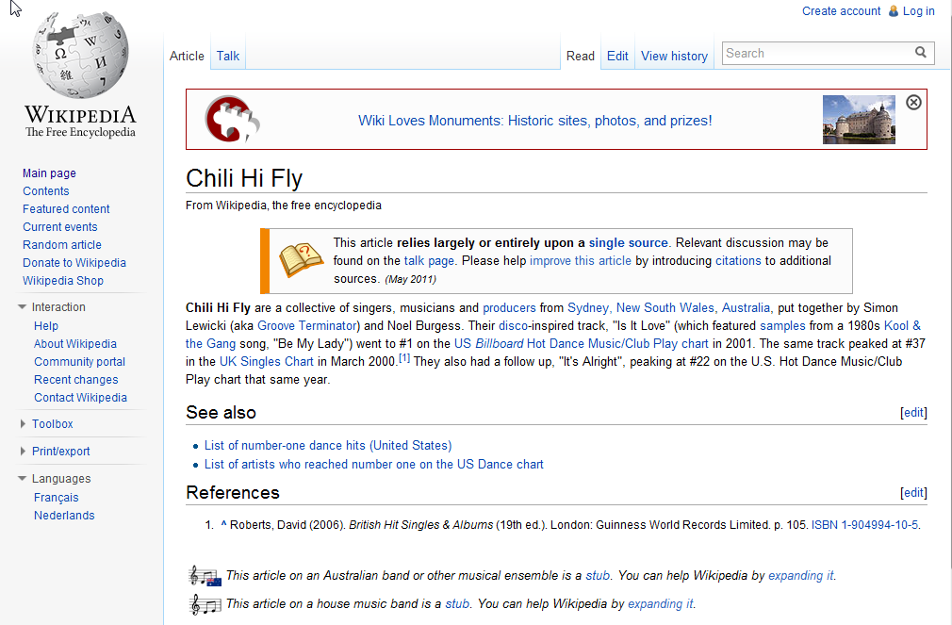

Slide 65
* Preferred Name for the Corporate Body:
* Location of Conference, Etc. (MARC 370 $e):
** Location of Headquarters (MARC 370 $e):
* Date of Conference, Etc. (MARC 046 $s $t):
* Date of Establishment (MARC 046 $s):
* Date of Termination (MARC 046 $t):
† ††Associated Institution MARC 373):
* Number of a Conference, Etc.:
‡ **Other Designation Associated with the Corporate Body (MARC 368 $a $b $c):
Language of the Corporate Body (MARC 377):
Address of the Corporate Body (MARC 371):
Field of Activity of the Corporate Body (MARC 372):
Corporate History (MARC 678):
Authorized access point for the corporate body: 1__ __ $a
* Core element
** Core element if needed to distinguish a corporate body from another corporate body with the same name
† Core element for conferences if name provides better identification than local place or if local place unknown or cannot be readily ascertained
†† Core element for other corporate bodies if the institution’s name provides better identification than the local place name or if the local place name is unknown or cannot be readily determined, and it is needed to distinguish the corporate body from another corporate body with the same name
‡ Core element for a body with a name that does not convey the idea of a corporate body

Slide 66
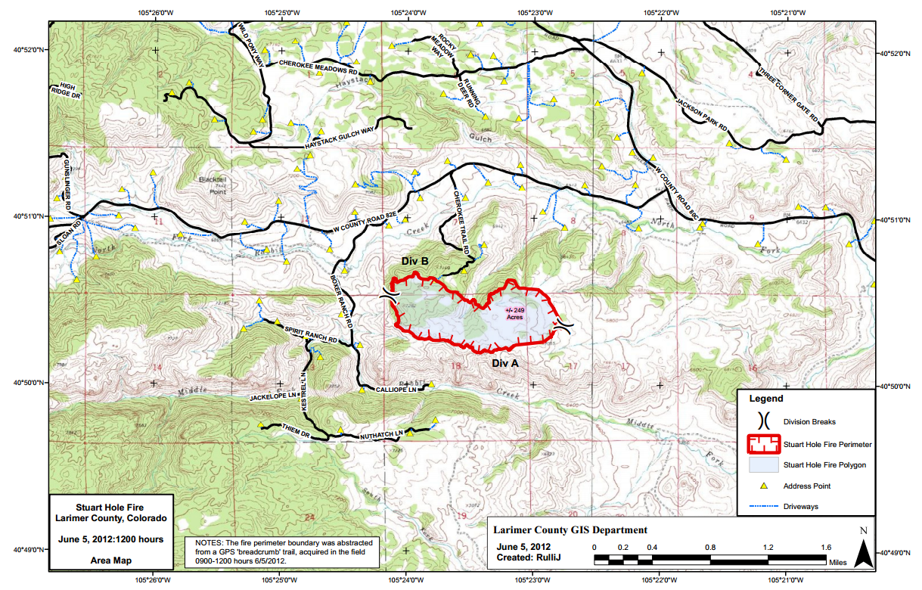
Exercise 4a – Determine the authorized access point for the corporate body related to this resource

Slide 67
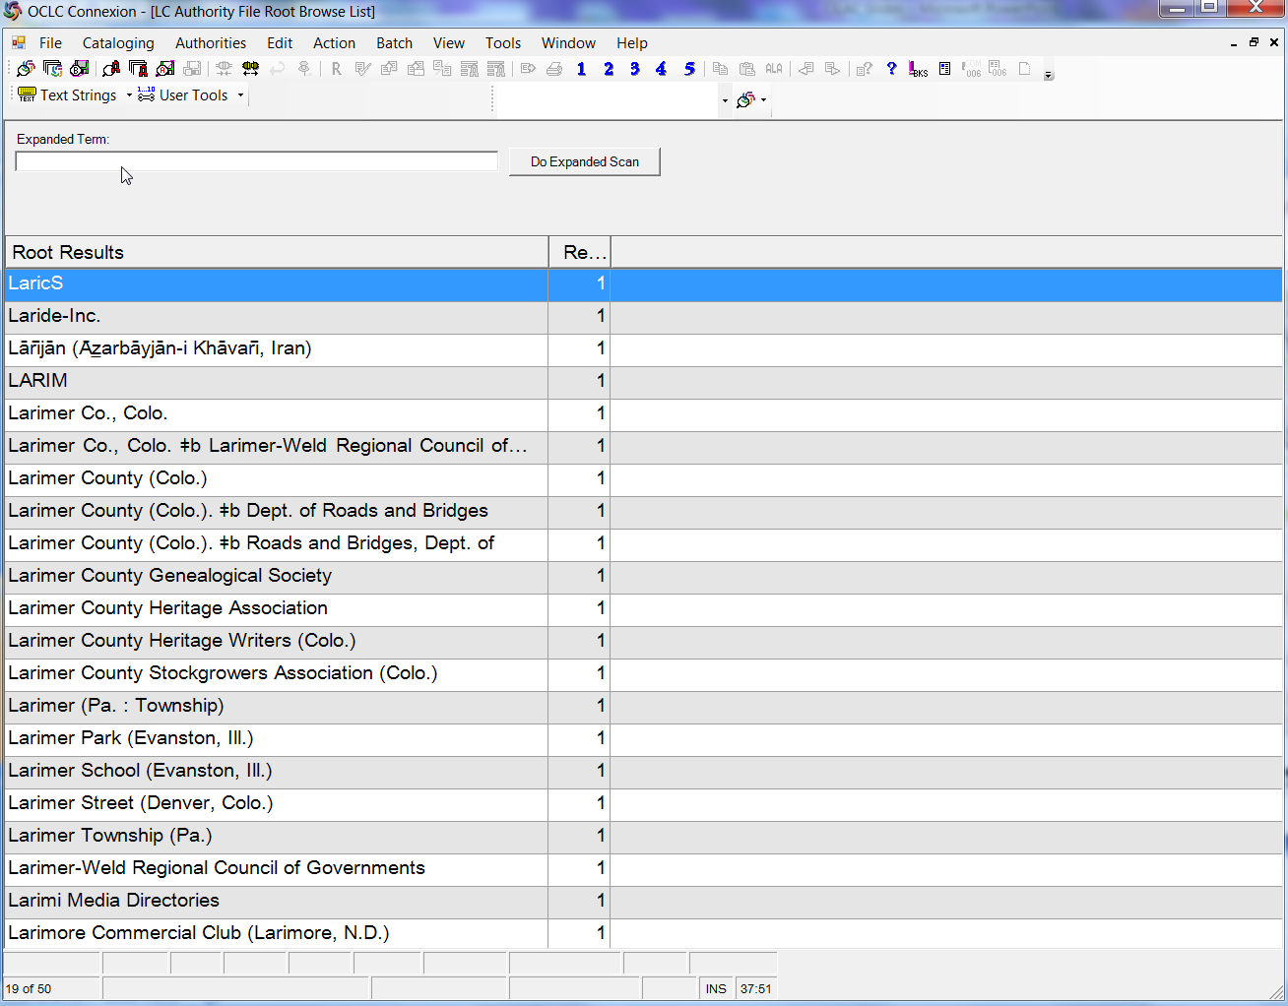
Corporate body browse in OCLC authority file

Slide 68
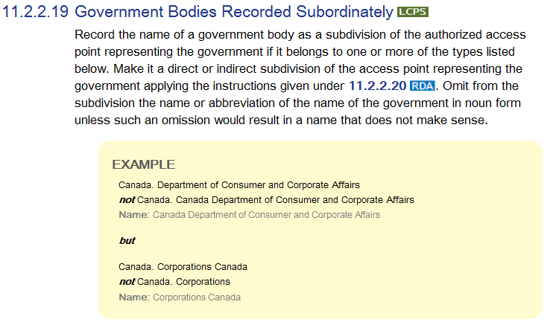
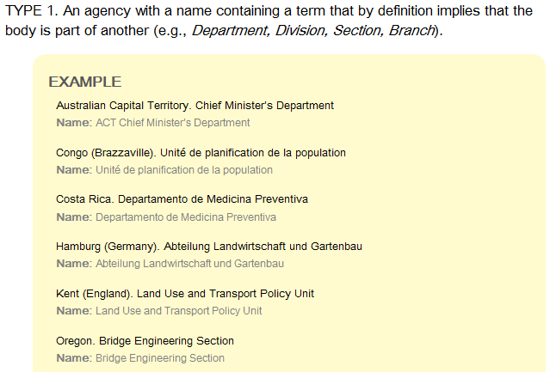
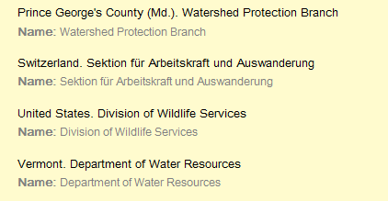
Relevant RDA Instructions

Slide 69
* Preferred Name for the Corporate Body:
* Location of Conference, Etc. (MARC 370 $e):
** Location of Headquarters (MARC 370 $e):
* Date of Conference, Etc. (MARC 046 $s $t):
* Date of Establishment (MARC 046 $s):
* Date of Termination (MARC 046 $t):
† ††Associated Institution MARC 373):
* Number of a Conference, Etc.:
‡ **Other Designation Associated with the Corporate Body (MARC 368 $a $b $c):
Language of the Corporate Body (MARC 377):
Address of the Corporate Body (MARC 371):
Field of Activity of the Corporate Body (MARC 372):
Corporate History (MARC 678):
Authorized access point for the corporate body: 1__ __ $a
* Core element
** Core element if needed to distinguish a corporate body from another corporate body with the same name
† Core element for conferences if name provides better identification than local place or if local place unknown or cannot be readily ascertained
†† Core element for other corporate bodies if the institution’s name provides better identification than the local place name or if the local place name is unknown or cannot be readily determined, and it is needed to distinguish the corporate body from another corporate body with the same name
‡ Core element for a body with a name that does not convey the idea of a corporate body

Slide 70
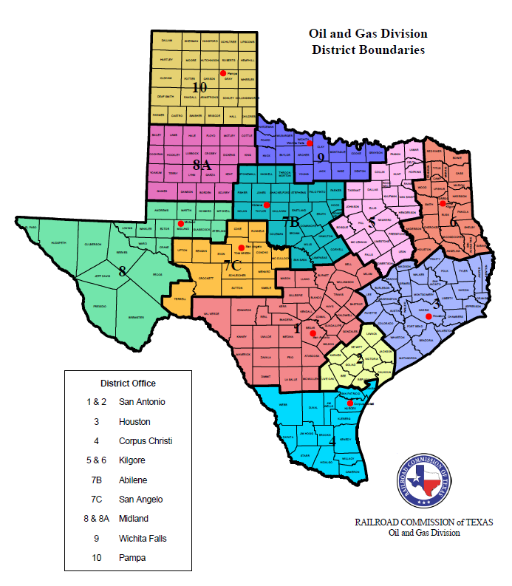
Exercise 4b – Determine the authorized access point for the creator of this map

Slide 71
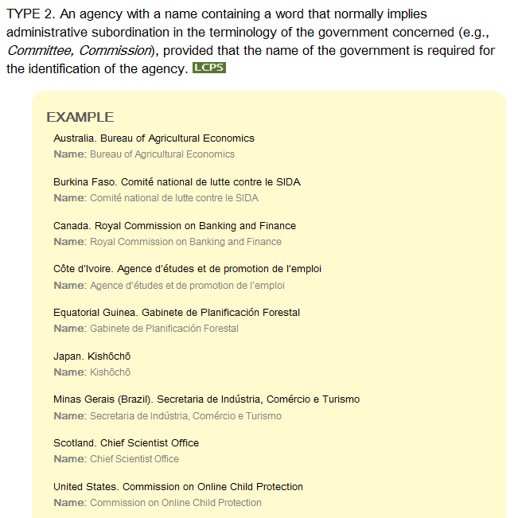
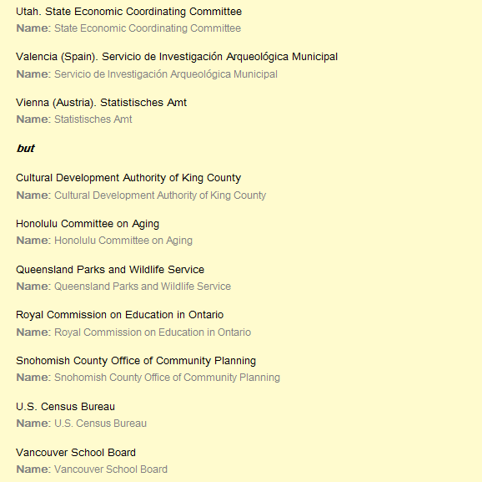
Relevant RDA Instructions

Slide 72
* Preferred Name for the Corporate Body:
* Location of Conference, Etc. (MARC 370 $e):
** Location of Headquarters (MARC 370 $e):
* Date of Conference, Etc. (MARC 046 $s $t):
* Date of Establishment (MARC 046 $s):
* Date of Termination (MARC 046 $t):
† ††Associated Institution MARC 373):
* Number of a Conference, Etc.:
‡ **Other Designation Associated with the Corporate Body (MARC 368 $a $b $c):
Language of the Corporate Body (MARC 377):
Address of the Corporate Body (MARC 371):
Field of Activity of the Corporate Body (MARC 372):
Corporate History (MARC 678):
Authorized access point for the corporate body: 1__ __ $a
* Core element
** Core element if needed to distinguish a corporate body from another corporate body with the same name
† Core element for conferences if name provides better identification than local place or if local place unknown or cannot be readily ascertained
†† Core element for other corporate bodies if the institution’s name provides better identification than the local place name or if the local place name is unknown or cannot be readily determined, and it is needed to distinguish the corporate body from another corporate body with the same name
‡ Core element for a body with a name that does not convey the idea of a corporate body

Slide 73
Exercise 5 – Determine the authorized access point for The Thrillseekers

Slide 74
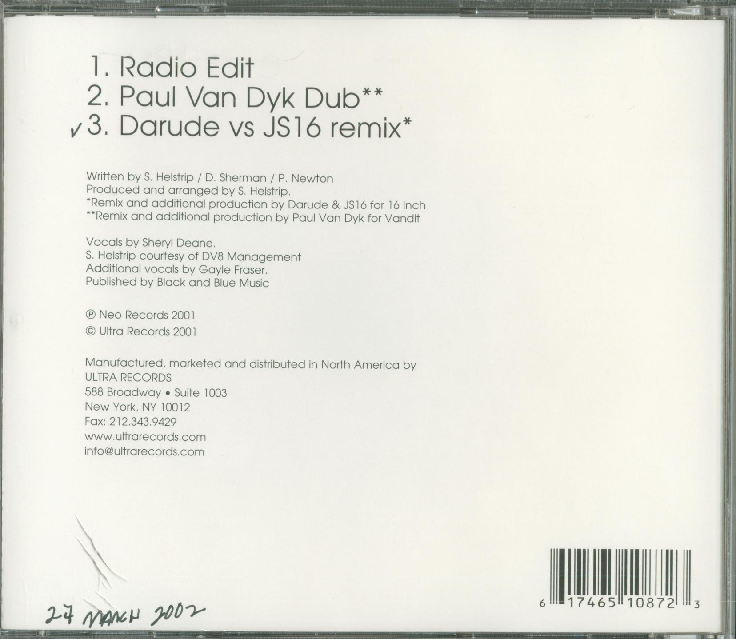

Slide 75
Info you’ve found
No authority records in OCLC
OCLC AACR2 bib records have the following headings:
110 2_ Thrillseekers (Musical group)
710 2_ Thrillseekers (Musical group)
Three German National Library non-AACR2 bib records have the heading:
700 0_ Thrillseekers.

Slide 76
Info you’ve found
VIAF has two authority records from the German National Library:

Slide 77
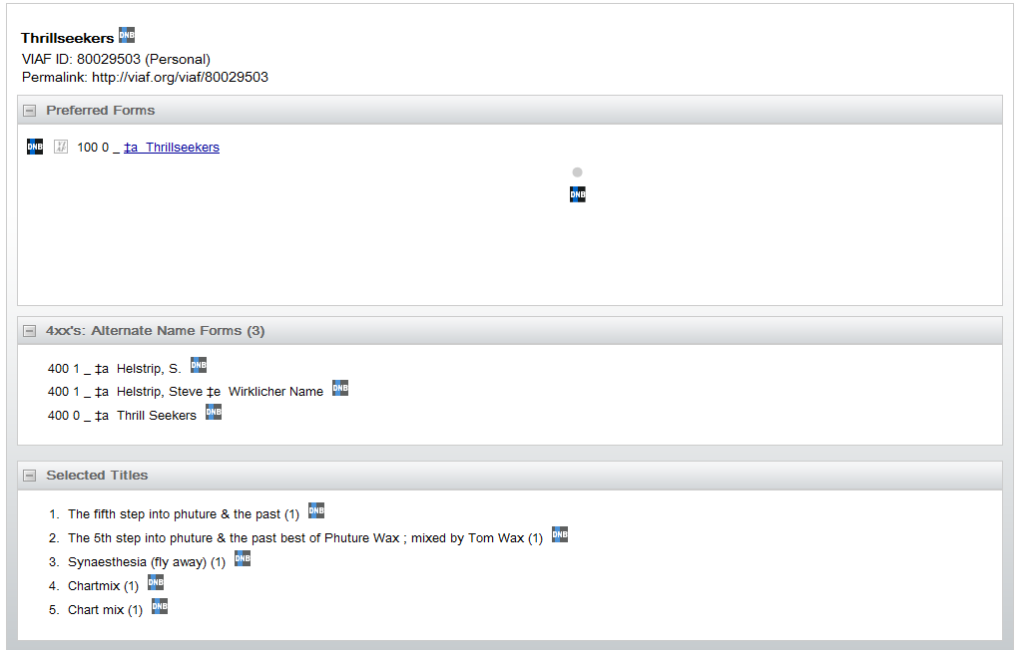
Wirklicher Name = Real name

Slide 78
More info you’ve found
Wikipedia: The Thrillseekers (born Steve Helstrip) is the name of an English trance DJ, record producer and remixer. He has been at the forefront of the trance genre since the release in 1998 of his critically acclaimed track, "Synaesthesia (Fly Away).“
CubeTrance website: U.K. based producer Steve Helstrip better known as The Thrillseekers
Discogs website:
Thrillseekers, The
Real Name: Steven Robin Helstrip
iTunes website: The Thrillseekers; Biography: Thrillseekers (aka Steve Helstrip) started out making music like many aspiring producers, via a home studio. Originally, Helstrip was working on video game music for a well-known video game company, when his debut 12" was picked up and aggressively promoted by trance juggernaut DJ Paul Van Dyk. After extensive studio work, Helstrip also began to pursue a DJ career.

Slide 79
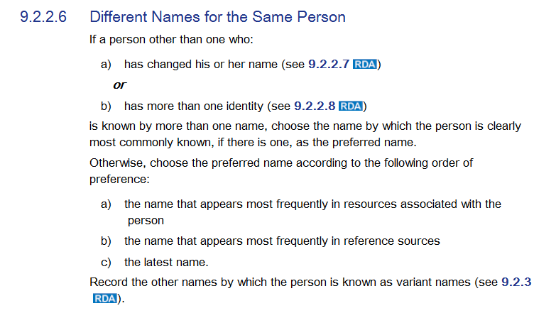
Relevant RDA Instructions

Slide 80
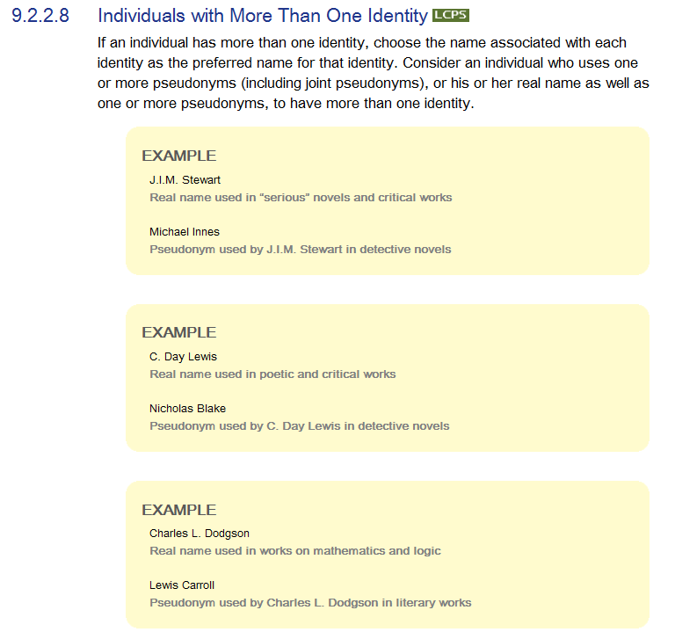
Relevant RDA Instructions
Notes:
LCPS for 9.2.2.8. INDIVIDUALS WITH MORE THAN ONE IDENTITY
LC practice: If an authorized access point is needed for a bibliographic identity recorded as a variant name in a 400 field in an AACR2 name authority record, create a separate RDA name authority record for that identity. Modify the existing authority record to convert the 400 field to a 500 field.

Slide 81
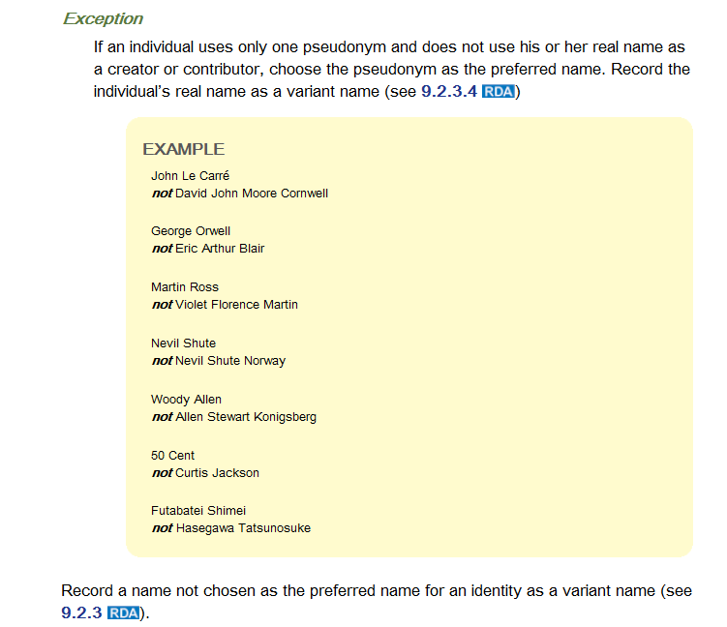
Relevant RDA Instructions

Slide 82
Based on the information you’ve found, what type of entity is The Thrillseekers?
What is the preferred name of the entity?
What other RDA elements are you likely to need to record in an authority record for this entity? (See previous slides for lists of elements)
Construct an authorized access point for the entity:
1__ __ $a

Slide 83
Relationship Designators Exercise

Slide 84
Use relationship designators from RDA Appendix J to relate these two works in authority records

Slide 86
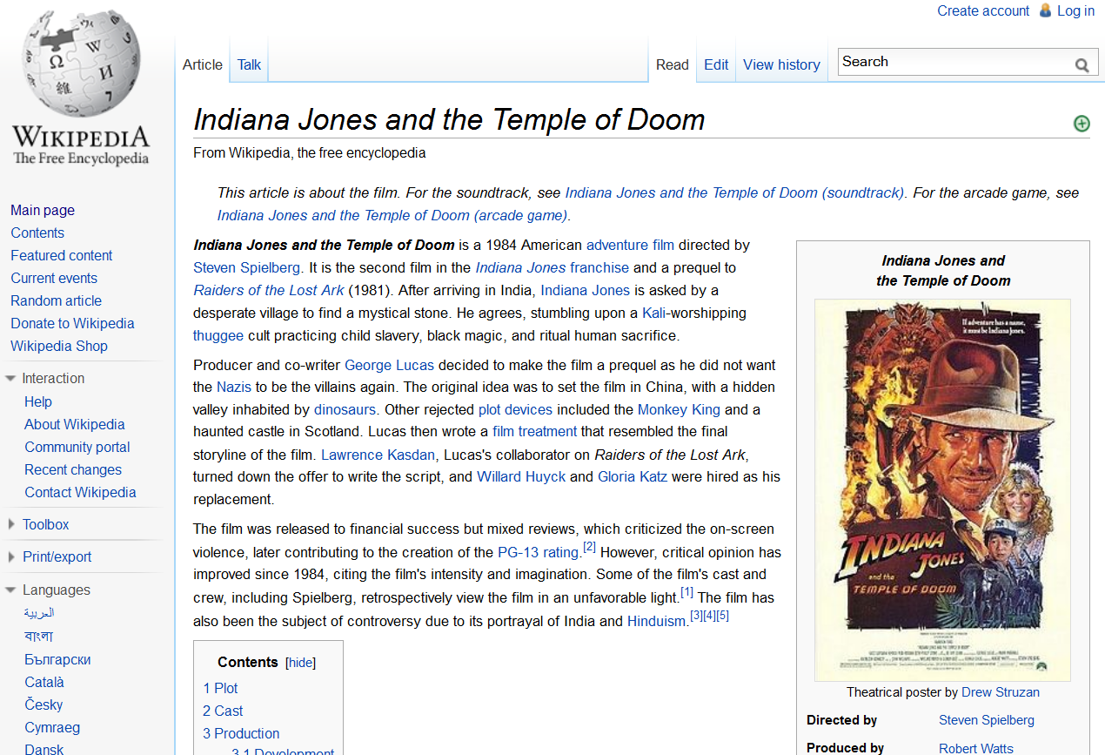

Slide 87
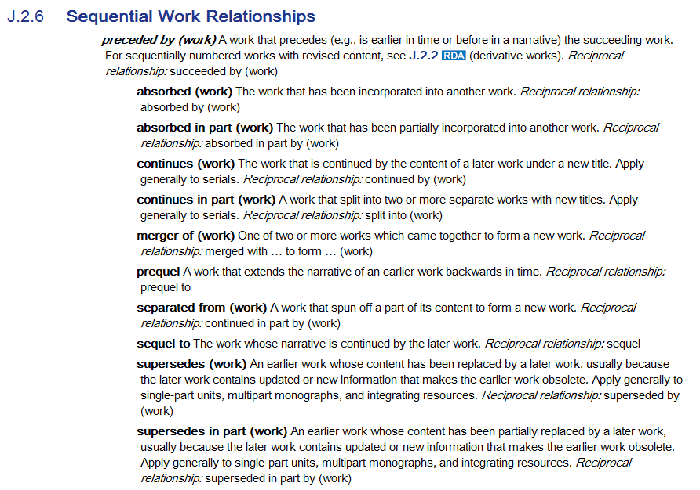

Slide 88
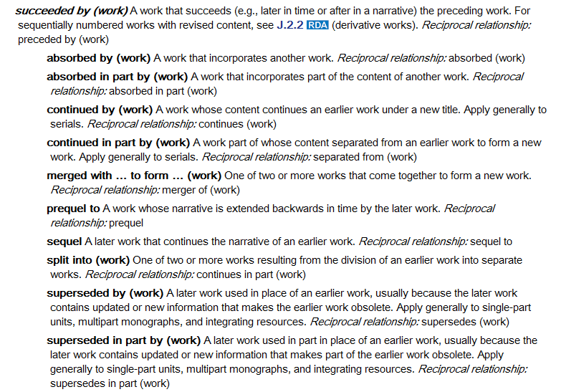

Slide 89
In Authority Records
130 _0 $a Indiana Jones and the Temple of Doom (Motion picture)
430 _0 $a Temple of Doom (Motion picture)
___ __ $______________ $_ Raiders of the lost ark (Motion picture) $__
130 _0 $a Raiders of the lost ark (Motion picture)
430 _0 $a Indiana Jones and the raiders of the lost ark (Motion picture)
___ __ $______________ $_ Indiana Jones and the Temple of Doom (Motion picture)
$__
In Bibliographic Records
130 _0 $a Indiana Jones and the Temple of Doom (Motion picture)
245 10 $a Indiana Jones and the Temple of Doom / $c Paramount Pictures presents a ...
___ __ $______________ $_ Raiders of the lost ark (Motion picture)
130 _0 $a Raiders of the lost ark (Motion picture)
245 10 $a Raiders of the lost ark / $c Paramount Pictures presents a Lucasfilm Ltd. ...
___ __ $______________ $_ Indiana Jones and the Temple of Doom (Motion picture)

Slide 90
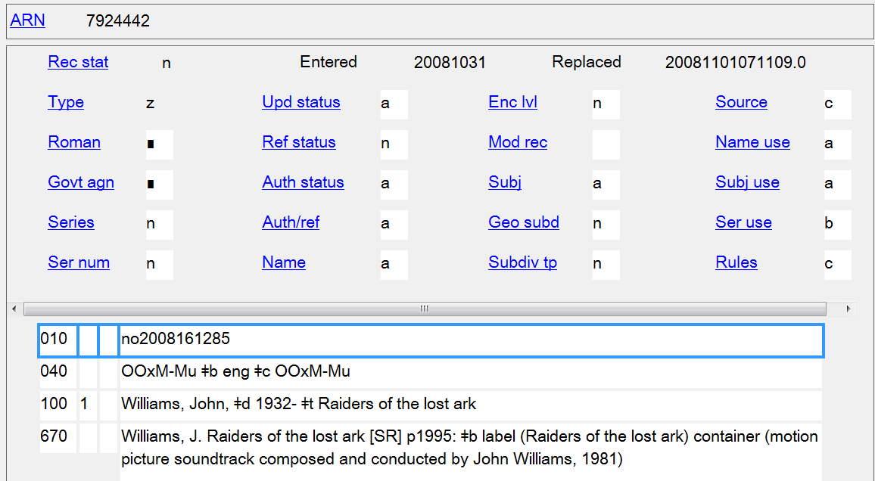
How would you relate this work to the film for which it was composed?

Slide 91
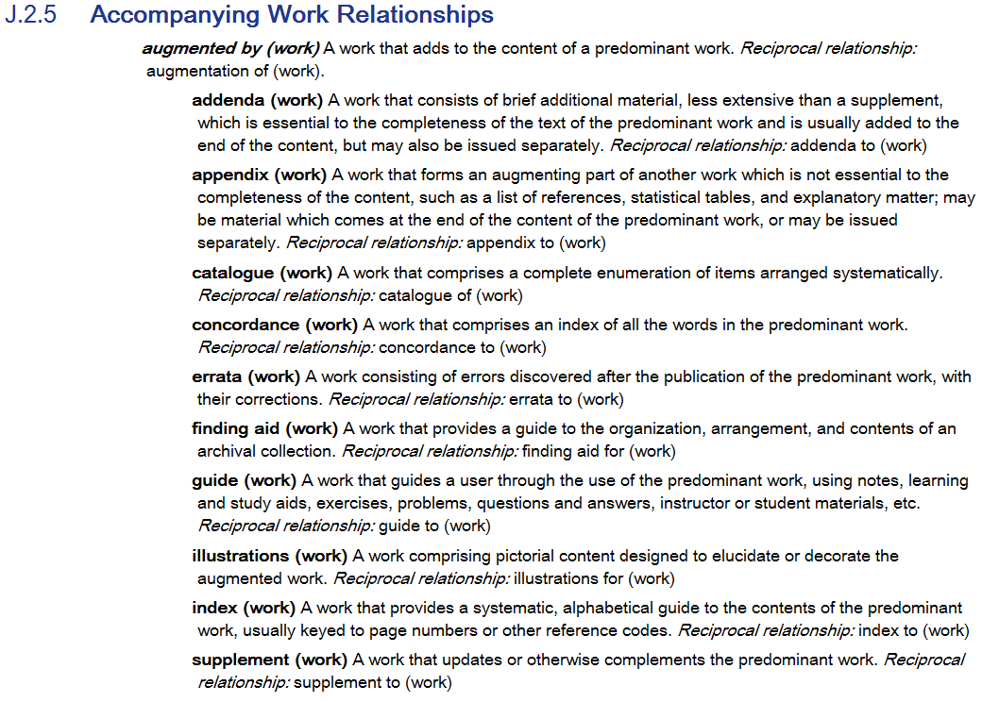

Slide 92
